Slide 1
Group 1 Project Updates
Stat 6080 Data Technologies
Nov 11, 2021

Slide 2
Task Leads
Ragan Astle (Group Leader):
Graphics Lead
Latex Document Lead
McKade Thomas
Report Lead
Nate Nellis
Data Analyst Lead
Tyler Antoloci
Latex Beamer Lead
Web Scrape Lead

Slide 3
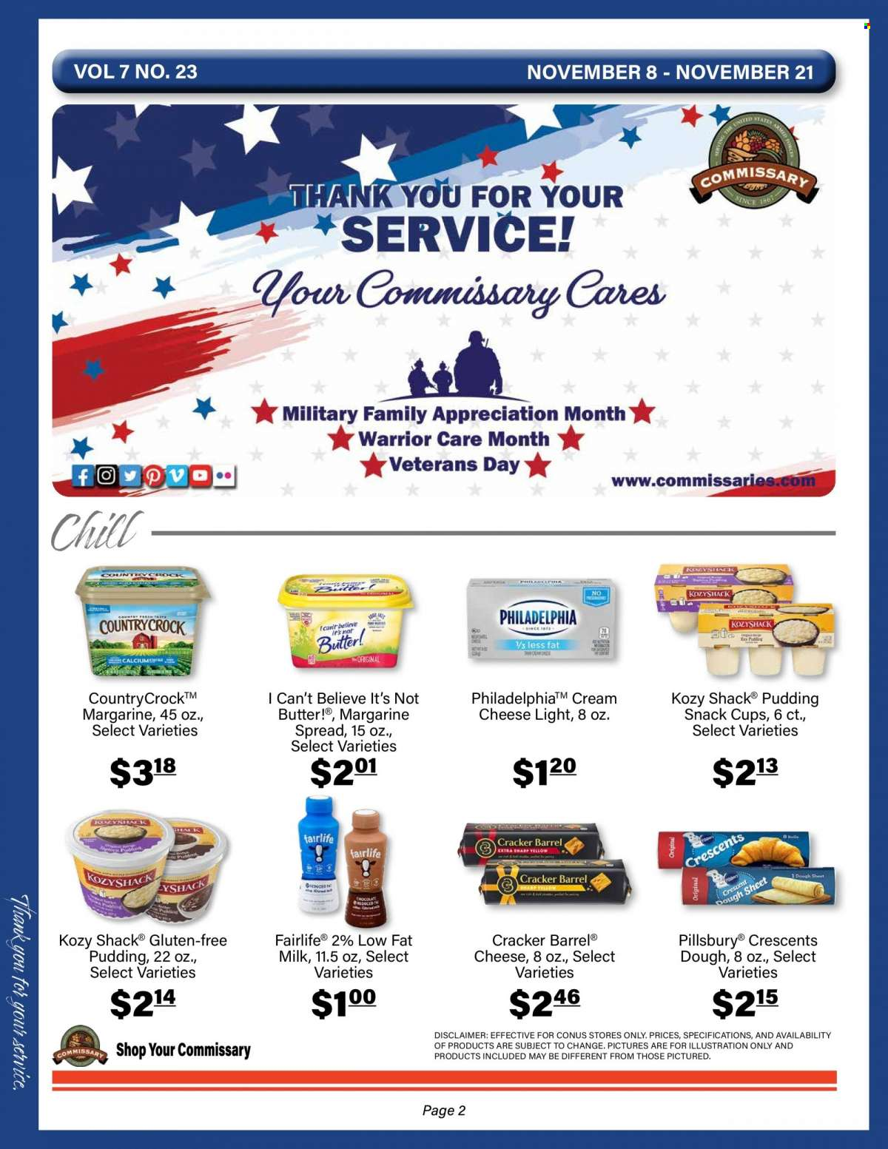
Ad Information
Store Chain: Commissary Hill
Most recent ad available in PDF format on Commissary website
Weekly Ads website has ads since 2018 in image format
https://weekly-ads.us/hill/commissary/7541-6th-st

Slide 4
Progress Update
Automated scraping/sampling:
After initial success using a workaround in Python, we ran into further troubles with too many API calls (resulting in the webpage blocking our IP address).
The website allows access again after a few hours, so a final attempt will be made to scrape the page by pausing the loop after each run. If this attempt is unsuccessful, we will resort fully to OCR/working with a sample the image files.
OCR optimization:
Investigating use of image cropping
Found a few optimal OCR methods, image_modulate(), image_noise()

Slide 5
Current Challenges
Webpage blocks our IP address for several hours after scraping attempt.
Image cropping has proved difficult (but not impossible) due to the inconsistency between ad pages.

Slide 6
Moving Forward
Attempt to scrape the webpage a final time by pausing the system in between iterations.
If this fails, grab a sample of image files from October – December of each year.
Look at holiday trends
Improve image cropping to locate correct elements of the image files.

Slide 7
Questions?

